Slide 1
K-MEANS CLUSTERING

Slide 2
INTRODUCTION-
What is clustering?
Clustering is the classification of objects into different groups, or more precisely, the partitioning of a data set into subsets (clusters), so that the data in each subset (ideally) share some common trait - often according to some defined distance measure.

Slide 3
Types of clustering:
Hierarchical algorithms: these find successive clusters
using previously established clusters.
1. Agglomerative ("bottom-up"): Agglomerative algorithms begin with each element as a separate cluster and merge them into successively larger clusters.
2. Divisive ("top-down"): Divisive algorithms begin with the whole set and proceed to divide it into successively smaller clusters.
2. Partitional clustering: Partitional algorithms determine all clusters at once. They include:
  K-means and derivatives
  Fuzzy c-means clustering
  QT clustering algorithm

Slide 4

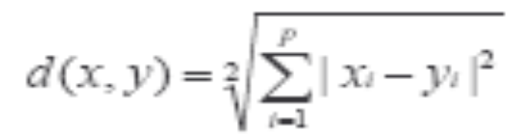
Common Distance measures:
Distance measure will determine how the similarity of two elements is calculated and it will influence the shape of the clusters.
They include:
1. The Euclidean distance (also called 2-norm distance) is given by:
2. The Manhattan distance (also called taxicab norm or 1-norm) is given by:

Slide 5

3.The maximum norm is given by:
4. The Mahalanobis distance corrects data for different scales and correlations in the variables.
5. Inner product space: The angle between two vectors can be used as a distance measure when clustering high dimensional data
6. Hamming distance (sometimes edit distance) measures the minimum number of substitutions required to change one member into another.

Slide 6
K-MEANS CLUSTERING
The k-means algorithm is an algorithm to cluster n objects based on attributes into k partitions, where k < n.
It is similar to the expectation-maximization algorithm for mixtures of Gaussians in that they both attempt to find the centers of natural clusters in the data.
It assumes that the object attributes form a vector space.

Slide 7

An algorithm for partitioning (or clustering) N data points into K disjoint subsets S_{j} containing data points so as to minimize the sum-of-squares criterion
where x_{n} is a vector representing the the n^{th} data point and u_{j} is the geometric centroid of the data points in S_{j}.

Slide 8
Simply speaking k-means clustering is an algorithm to classify or to group the objects based on attributes/features into K number of group.
K is positive integer number.
The grouping is done by minimizing the sum of squares of distances between data and the corresponding cluster centroid.

Slide 9

How the K-Mean Clustering algorithm works?

Slide 10
Step 1: Begin with a decision on the value of k = number of clusters .
Step 2: Put any initial partition that classifies the data into k clusters. You may assign the training samples randomly,or systematically as the following:
1.Take the first k training sample as single- element clusters
2. Assign each of the remaining (N-k) training sample to the cluster with the nearest centroid. After each assignment, recompute the centroid of the gaining cluster.

Slide 11
Step 3: Take each sample in sequence and compute its distance from the centroid of each of the clusters. If a sample is not currently in the cluster with the closest centroid, switch this sample to that cluster and update the centroid of the cluster gaining the new sample and the cluster losing the sample.
Step 4 . Repeat step 3 until convergence is achieved, that is until a pass through the training sample causes no new assignments.

Slide 12

A Simple example showing the implementation of k-means algorithm
(using K=2)

Slide 13


Step 1:
Initialization: Randomly we choose following two centroids (k=2) for two clusters.
In this case the 2 centroid are: m1=(1.0,1.0) and m2=(5.0,7.0).

Slide 14




Step 2:
Thus, we obtain two clusters containing:
{1,2,3} and {4,5,6,7}.
Their new centroids are:

Slide 15

Step 3:
Now using these centroids we compute the Euclidean distance of each object, as shown in table.
Therefore, the new clusters are:
{1,2} and {3,4,5,6,7}
Next centroids are: m1=(1.25,1.5) and m2 = (3.9,5.1)

Slide 16

Step 4 :
The clusters obtained are:
{1,2} and {3,4,5,6,7}
Therefore, there is no change in the cluster.
Thus, the algorithm comes to a halt here and final result consist of 2 clusters {1,2} and {3,4,5,6,7}.

Slide 17

PLOT

Slide 18
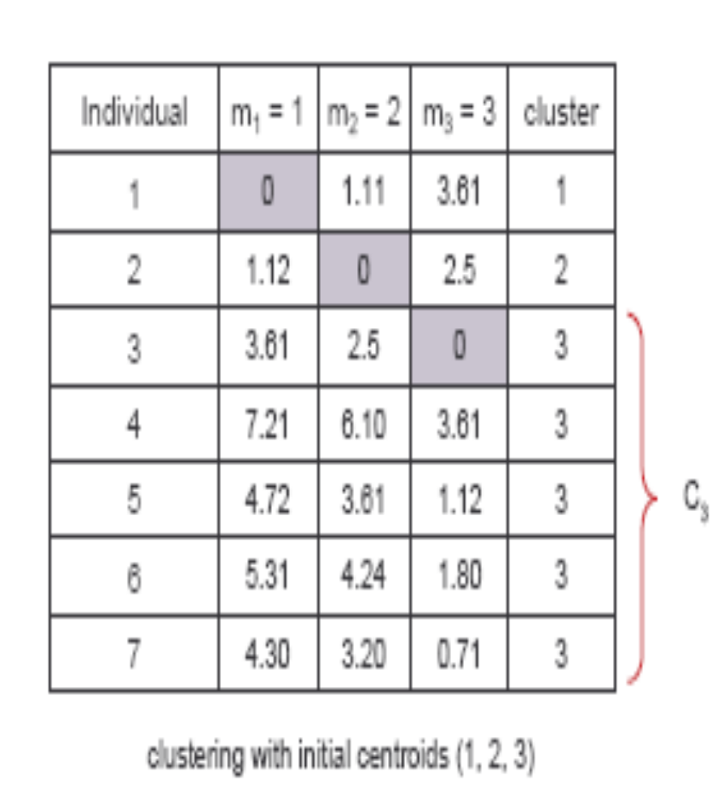
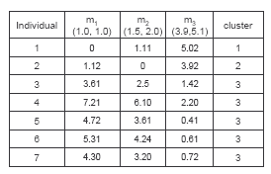
(with K=3)
Step 1
Step 2

Slide 19
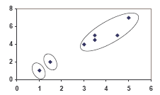
PLOT

